Slide 1
Recursion
Peek at Functional Programming
Week 1 / Lecture 1
Franck Chauvel
Axbit & NTNU
franck.chauvel@axbit.com

Slide 2
Sum of Integers
def sum_of_integers(n):
sum = 0
for i in range(n+1):
sum += i
return sum
How to rewrite this without a loop nor the known formula?
USE RECURSION

Slide 3
Agenda
What is “Recursion”?
Examples
How to design “recursive” procedures?
Recursion vs. Iteration
Efficiency of Recursive Procedures
Recap

Slide 4
1.What is “Recursion”?

Slide 5

A Definition
“Recursion occurs when a thing is defined in terms of itself or of its type”.
—Wikipedia
A procedure that calls itself
A definition that refers to itself

Slide 6
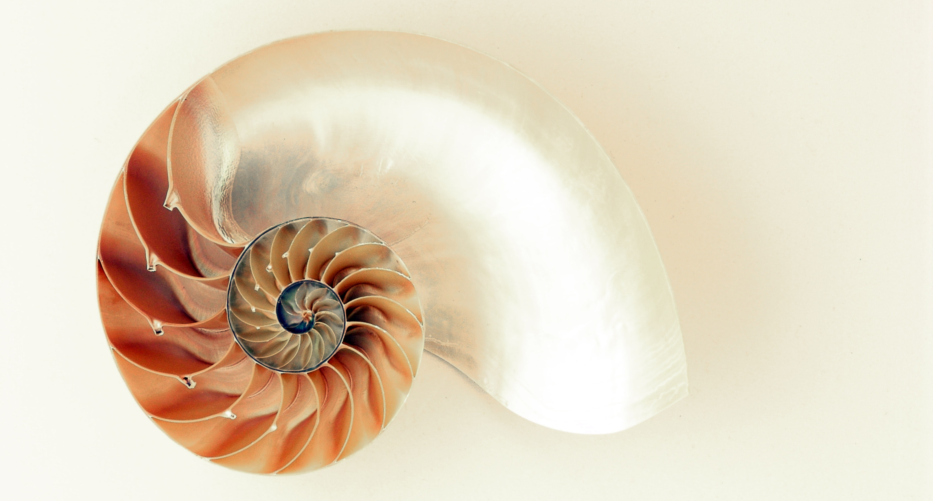

In Nature

Slide 7
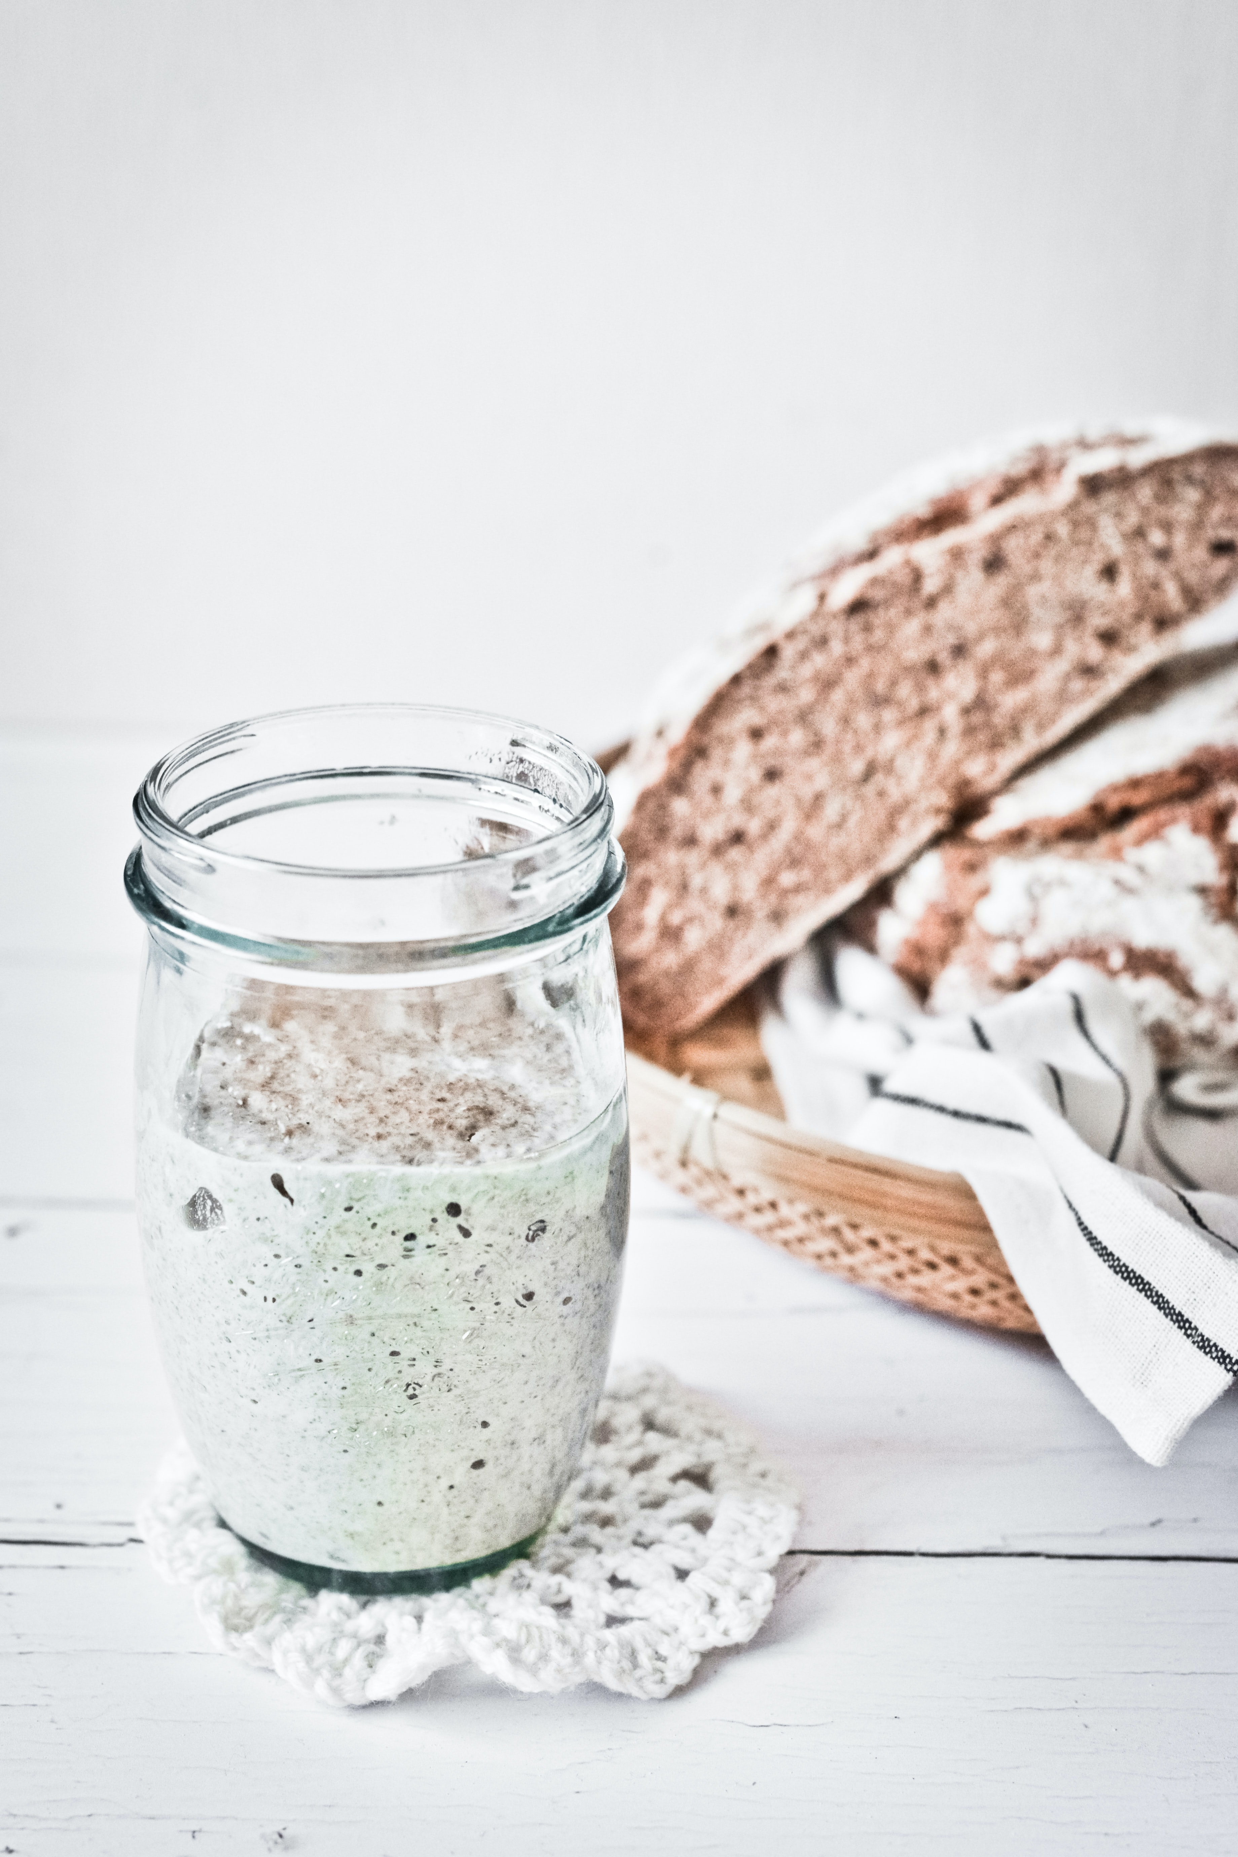
In Cooking
Photo by Margaret Jaszowska on Unsplash
How to make 200 g of sour dough?
Take 100 g of sour dough
Add 50 g of water
Add 50 g of flour
Let it rest

Slide 8
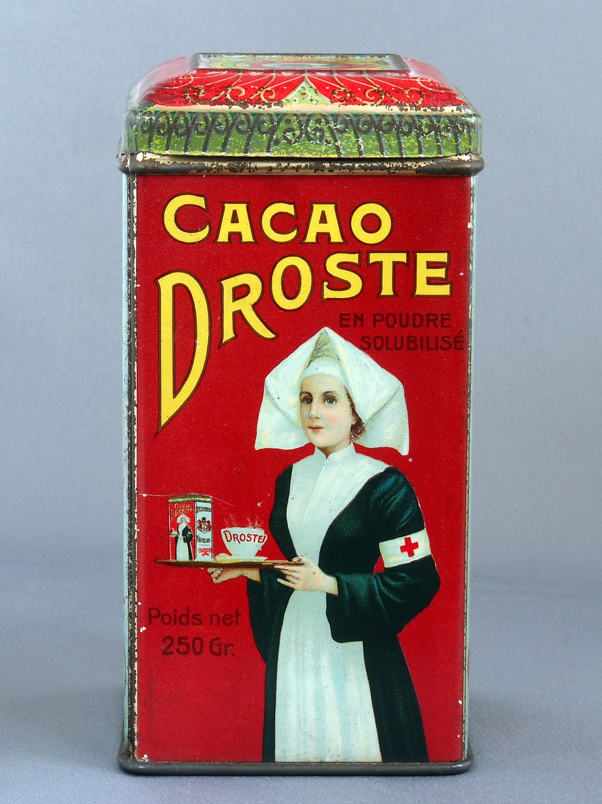

In Arts
Place a copy of the image in itself!

Slide 9
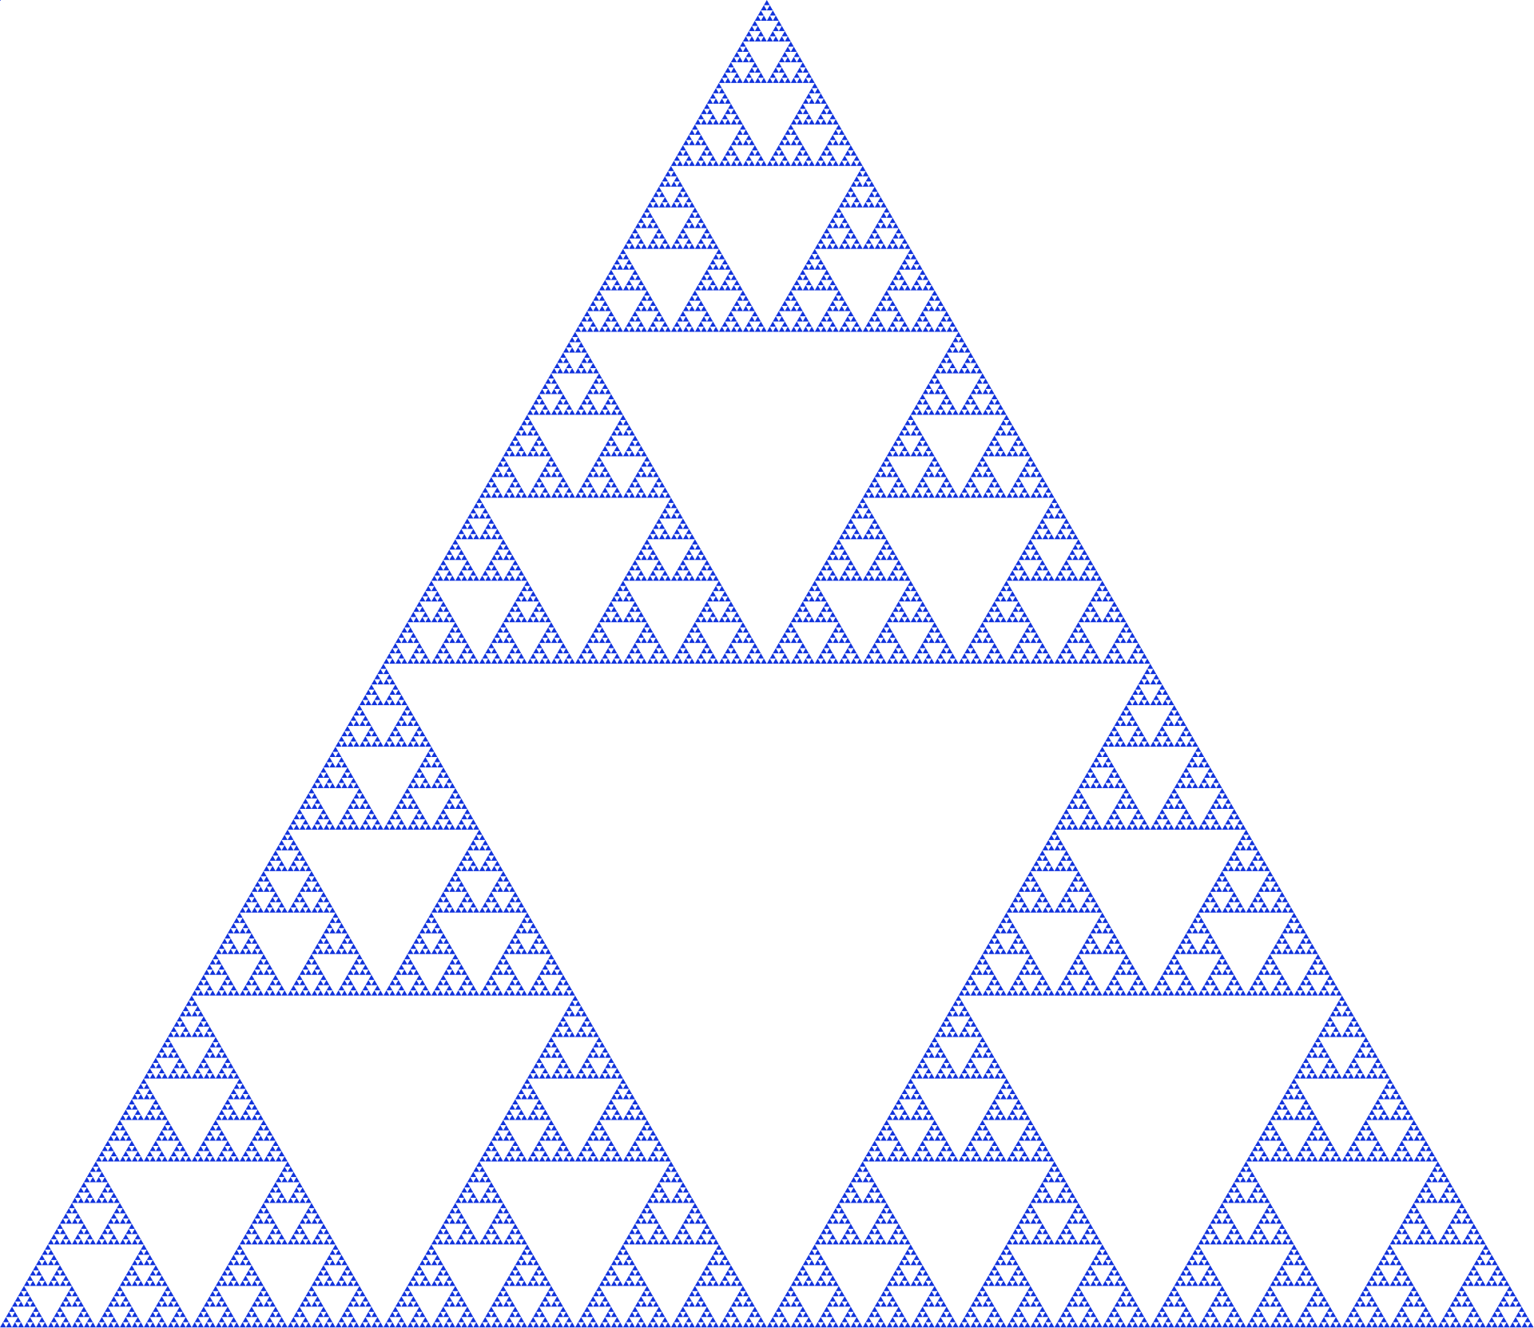
In Maths
Geometry, fractals
Recurrence relation
Difference equations

Slide 10
2. Examples

Slide 11
Sum of Integers
def sum_of_integers(n):
sum = 0
for i in range(n+1):
sum += i
return sum
def sum_of_integers(n):
if n==1:
return 1
return n + sum_of_integers(n-1)

Slide 12
Factorial
def factorial(n):
total = 1
for each in range(1, n+1):
total *= each
return total
def factorial(n):
if n == 1:
return 1
return n * factorial(n-1)

Slide 13
Binary Search
def search(array, value):
lower = 0
upper = len(array)
while (upper - lower) > 1:
split = (upper + lower) // 2
if value == array[split]:
return split
elif value < array[split]:
upper = split
else:
lower = split
return -1

Slide 14
Binary Search—Recursive
def search(array, value):
return do_search(array, 0, len(array), value)
def do_search(array, lower, upper, value):
split = (lower + upper) // 2
if value == array[split]:
return split
elif value < array[split]:
return do_search(array, lower, split, value)
else:
return do_search(array, split, upper, value)

Slide 15
3. How to design Recursive Procedures?

Slide 16
Thought Process
def sum_of_integers(n):
if n==1:
return 1
return n + sum_of_integers(n-1)
base case

Slide 17
Alternatives

Slide 18
A Methodology
What is the size of the problem?
What are the base cases?
Break down the problem into self-similar sub-problems of smaller size
What are the recursive cases?
Test and refine

Slide 19
4. Recursion vs. Iteration

Slide 20
Expressiveness
Recursion
Iteration

Slide 21
Efficiency
def sum_of_integers(n):
sum = 0
for i in range(n+1):
sum += i
return sum
def sum_of_integers(n):
if n==1:
return 1
return n + sum_of_integers(n-1)
print(sum_of_integers(1000))
print(sum_of_integers(1000))
500500
[Previous line repeated 995 more times]
File "/Users/fchauvel/…/recursion.py", line 2, in sum_of_integers
if n==1:
RecursionError: maximum recursion depth exceeded in comparison

Slide 22
Stack Overflow
Call-stack
The call stack has grown too big!
Each call takes space!
Call-stack
Free Memory
Call-stack
growth
!
Heap
Heap
growth
Static data
Address
Program Instructions

Slide 23
Slow Motion
Stack
Previous frames
n = 5
result = ??
def sum_of_integers(n):
if n==1:
return 1
return n + sum_of_integers(n-1)
n + 10 = 15
n = 4
result = ??
n + 6 = 10
n = 3
result = ??
n + 3 = 6
print(sum_of_integers(5))
n = 2
result = ??
n + 2 = 3
Address
n = 1
result = 1

Slide 24
Tail Call Optimisation
Stack
Previous frames
def sum_of_integers(n):
return do_sum(0, n)
def do_sum(acc, n):
if n == 1:
return acc + 1
return do_sum(acc+n, n-1)
n = 5 4 3 2 1
acc = 0 5 9 12 14
n = 5
acc = 0
n = 5 4
acc = 0 5
n = 5 4 3
acc = 0 5 9
n = 5 4 3 2
acc = 0 5 9 12
Address
print(sum_of_integers(5))

Slide 25
Tail Call Optimization
Language | Paradigm | TCO? | Note
C/C++ | Procedural |  | Yes for GCC
Python | Multi
Ruby | Multi | Yes | Optional
JavaScript | Multi | Yes | In ECMAScript v6
Java | OO
C# | OO
Scheme | Functional | Yes
Haskell | Functional | Yes
Ocaml | Functional | Yes
Scala | Functional | Yes

Slide 26
Recap
Recursion
Procedures that call themselves
Useful design strategy
Problem size: Convergence
Base cases
Recursive cases
Recursion vs. Iteration?
Think Tail recursion!
Next
Efficiency of recursive procedures

Slide 27
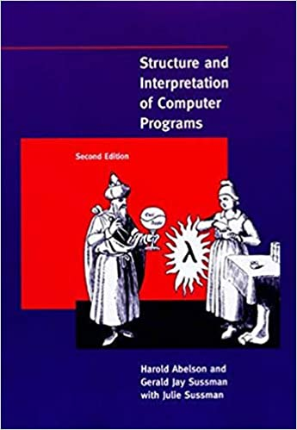
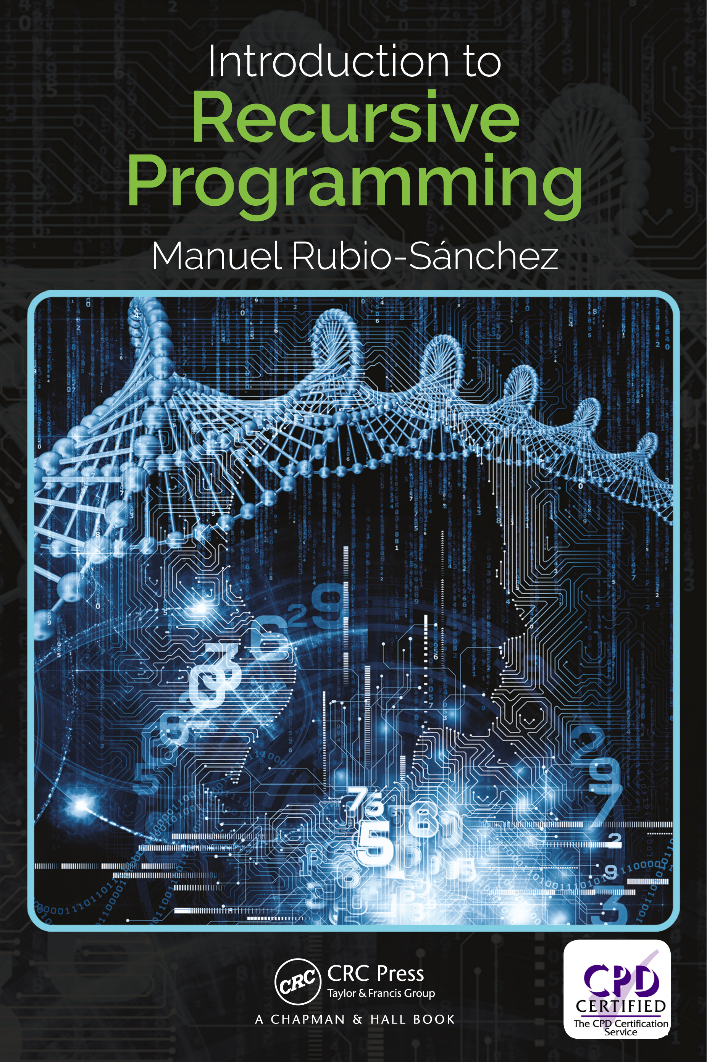
Relevant Readings
Abelson, Harold, and Gerald Jay Sussman. Structure and interpretation of computer programs. The MIT Press, 1996.
Rubio-Sánchez, Manuel. Introduction to recursive programming. CRC Press, 2017.

Slide 28
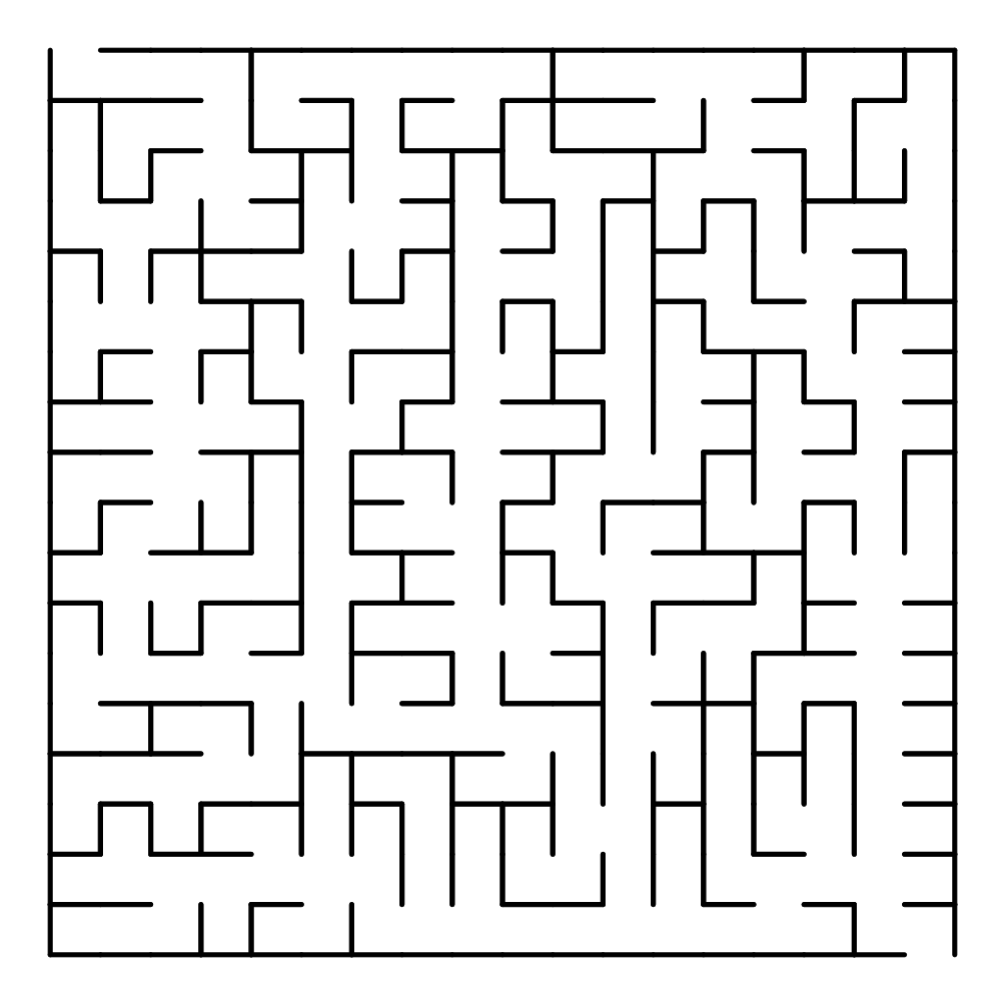
Lab Session

Slide 29
Questions, Comments, or Ideas?
Franck Chauvel
Axbit & NTNU
franck.chauvel@gmail.com

